Slide 1

Rock buster Stealth Business Analysis: Launch Strategy for the Online Video Rental Service
-Sreelaya Narla

Slide 2

Introduction
About Rockbuster Stealth LLC
Rockbuster Stealth LLC is a global movie rental company that previously operated physical stores worldwide. With the rapid growth of streaming platforms like Netflix and Amazon Prime, Rockbuster has experienced a decline in traditional rental revenues.
The Challenge
To remain competitive in the digital entertainment market, Rockbuster plans to leverage its existing library of movie licenses and launch a new online video rental service.
My Role As a Data Analyst in Rockbuster’s BI team, I used SQL to analyze company data, answer key business questions, and present insights through clear visualizations for the Management Board.

Slide 3
Project Objectives
Business Goal
Support Rockbuster Stealth’s transition to an online video rental platform with actionable, data-driven insights.
Key Questions from Management
Which movies contributed the most or least to revenue?
What was the average rental duration for all videos?
Which countries are Rockbuster customers based in?
Where are high lifetime value customers located?
Do sales figures vary between geographic regions?

Slide 4
Tools & Workflow
Tools Used
🐘 PostgreSQL – To store and query Rockbuster’s relational database
🧮 SQL – To extract, filter, and aggregate data for business analysis
📊 Tableau / Excel – To visualize insights and trends for clear presentation
PostgreSQL for data storage
Explore data base schemas
SQL for querying
SQL for querying
Analysis
Visualize insights in Tableau/excel

Slide 5
Summary Statistics
🎟️ Rental Prices
Minimum Price: €0.99
Maximum Price: €4.99
Average Price: €2.98
⏱️ Rental Duration
Minimum Duration: 3 days
Maximum Duration: 7 days
Average Duration: 5 days
👥 Customer & Rental Overview
Total Customers: 599
Total Rentals: 16,044
Despite a modest customer base, Rockbuster sees strong engagement, with each customer averaging 27 rentals per year and a typical rental lasting 5 days. This indicates high loyalty and consistent demand across the platform.

Slide 6
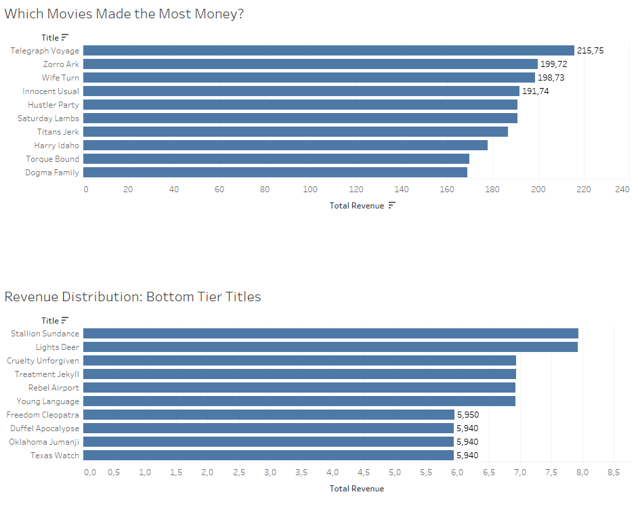
Which movies contributed the most or least to revenue?
The Top 10 movies make up just 3% of Total revenue, indicating revenue is broadly spread across many films.
While the lowest-earning movies generate only 5,94€, a closer look reveals that these three titles are all priced at 0,99€ and have been rented 6 times. In contrast, the more frequently rented movie in this group have been rented 29 times. This suggests that increasing the 0,99€ price point could be a strategic move to boost revenue.

Slide 7
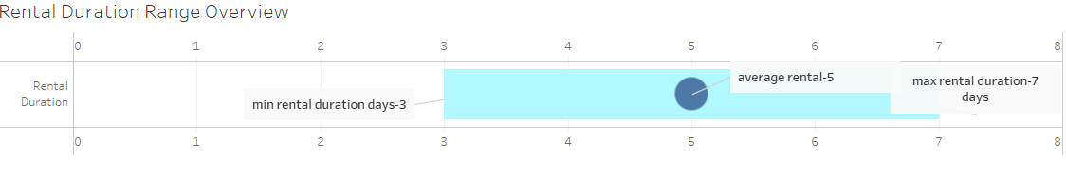
Average Rental Duration What is the average rental duration?
On average, customers rented movies for 5 days, with rental periods ranging from 3 to 7 days

Slide 8
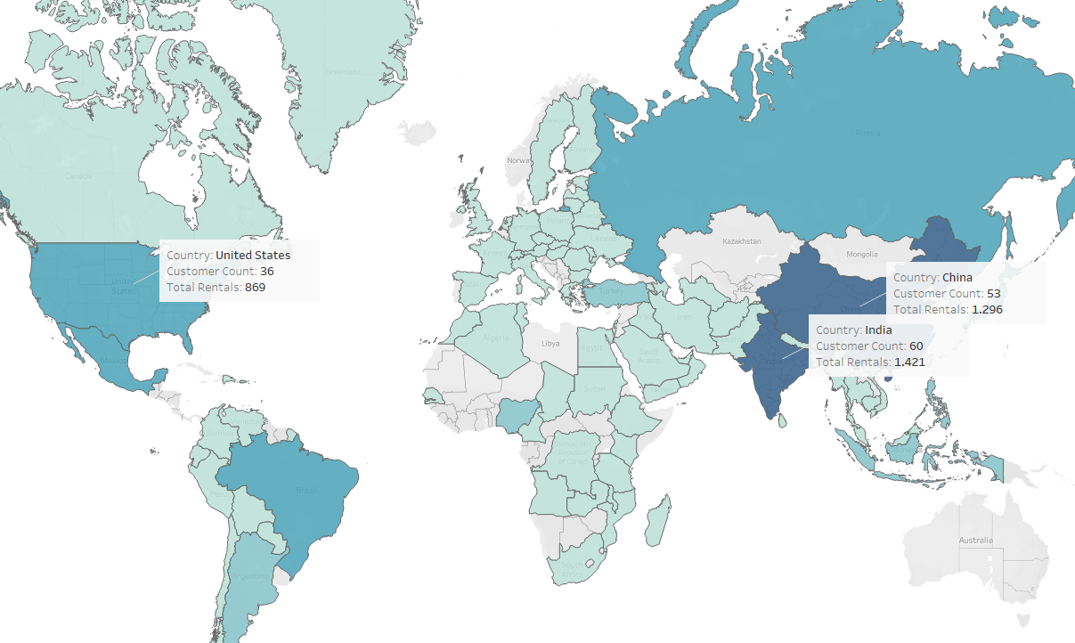
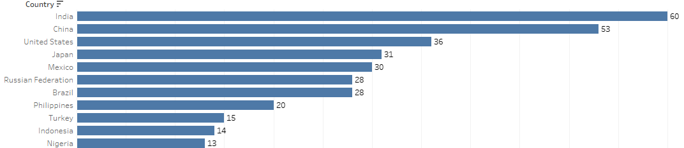
Where are our customers located? The darker colours indicate higher customer counts.

Slide 9
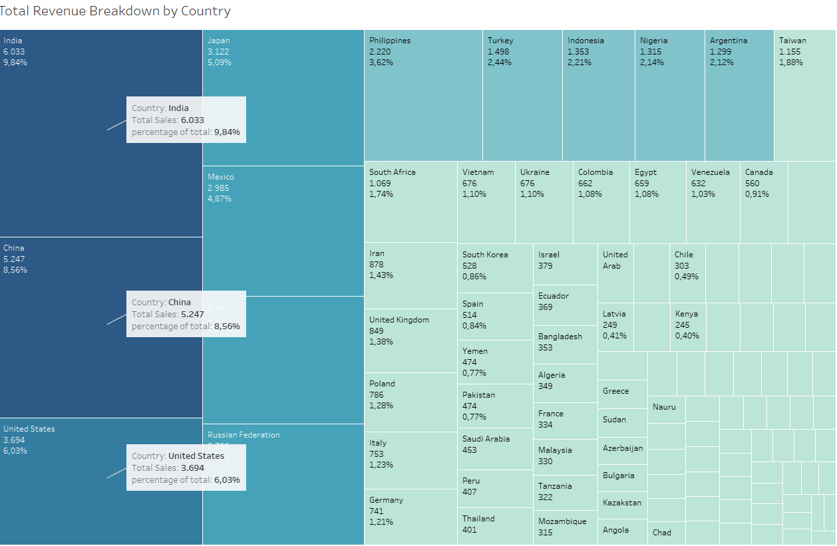
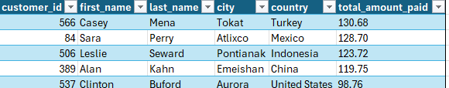
Who are our most valuable customers? Rockbuster’s customer count directly influences sales across regions. India leads with 60 customers and €6,032.79 in sales, with each customer renting 23 films annually showing strong engagement.
Top 5 customers in the top countries

Slide 10
Summary of Findings
Revenue Distribution- Revenue is broadly distributed across a wide range of movie titles, with no single title dominating total earnings. This suggests that Rockbuster’s movie catalog has a balanced performance, offering multiple opportunities for monetization across genres and categories.
Top Customer Locations- The highest concentration of customers—and revenue—comes from countries such as India, China, Japan, Mexico, and the United States. These markets represent the strongest existing customer base and could serve as key targets for marketing efforts during the online platform launch.
Customer Loyalty-Loyal, high-value customers are primarily located in Asia and North America. These regions show consistent engagement and repeat rentals, indicating strong customer lifetime value. They are ideal for retention-focused strategies and upselling premium online offerings.
Online Platform-PotentialRockbuster’s transition to an online rental model has high growth potential, especially if it strategically focuses on the top-performing geographical regions identified. Leveraging current strengths in customer distribution and loyalty can provide a competitive edge in the streaming market.

Slide 11
Recommendations
1. Prioritize High-Potential Markets: Focus the initial online platform launch on the top 10 countries and cities with the highest customer concentration and revenue generation. This ensures a strong user base and higher chances of early adoption.
2. Target High-Value Customer Segments: Design marketing campaigns tailored to loyal and high-spending customers, especially in Asia and North America, to drive engagement and maximize customer lifetime value.
3. Optimize Content Licensing: Invest in licenses for top-performing movie titles, as they consistently generate revenue across markets. This will ensure customer satisfaction and efficient resource allocation.
4. Promote Longer Rental Durations: With an average rental duration of 5 days, there's clear customer interest in extended viewing. Promote longer rental packages or offer incentives for multi-day rentals to boost customer value.
5. Adjust Pricing Strategy: Consider raising the €0.99 rental price for high-demand titles with proven rental consistency. This slight increase can significantly improve profit margins without compromising user interest.
6. Implement a Loyalty Program: Introduce a loyalty or rewards program to encourage repeat rentals, strengthen customer relationships, and increase retention among frequent users.
7. Expand Movie Inventory: Diversify the platform’s content library to attract new customers and support ongoing growth. A wider selection can cater to broader tastes and encourage higher engagement.

Slide 12
Thank you
For further questions, please contact me. layanarla7@gmail.com

